Slide 1
Balanced Discussion
Several discussions; some broken down into individual sections to examine more closely with pupils. So check through slides before use.

Slide 2
Balanced Discussion
The purpose of a balanced discussion is to give both points of view.
Let the reader make up their mind.
balanced

Slide 3
Balanced Discussion
Should climbers be allowed to go up Mount Everest?
should not climb
up Everest
should climb up Everest
* leave litter / pollution
* many people die
* waste of money
* it’s a challenge / thrill
* locals get jobs / money
or

Slide 4
Should climbers be allowed to go up Mount Everest?
Points
Against climbing Mount Everest
* lots of pollution caused
* high death rate
* waste of money
For Climbing Mount Everest
* humans need challenges
* brings money to local communities

Slide 5
Example - Should climbers be allowed to climb Mount Everest? (P1)
Mount Everest is the tallest mountain in the world. It has fascinated man for centuries with some people believing that it is the ‘Home of the Gods’. Today, the mountain is climbed by so many people, it is now getting the reputation as the ‘Garbage dump of the World’. Isn’t now the time to stop this pointless pursuit and leave this beautiful mountain alone?
(point) The main reason that people should be stopped from climbing Mount Everest is because of the pollution that it causes. (explain) Hundreds of tons of human waste, abandoned climbing gear, tents, oxygen bottles and discarded food packing all litter the mountain and threaten to destroy an entire eco-system. (evidence) On Mount Everest alone it is estimated that 50 tonnes of rubbish are left by climbers every year.
(point) A second reason climbing should not be allowed is due to the high death rate. (explain) Many people set off up the mountain and are unprepared for the gruelling challenge ahead, and ultimately lose their lives on the way down. What other sport would allow so many people to participate with such a high risk of them not surviving? (evidence) Mount Everest is littered with bodies of climbers who never made it – still frozen in the snow. So far, the mountain has claimed the lives of 179 people.
(point) A final reason people should be stopped is because it is a complete waste of money. (explain) Millions of pounds are spent on climbing equipment every year in an attempt to conquer a mountain that has already being conquered! Surely this money could be spent more wisely elsewhere. (evidence) It has been estimated that the cost of one expedition up Mount Everest could be as much as £30,000.

Slide 6
Example - Should climbers be allowed to climb Mount Everest? (P2)
(balance) However, there is a very good case why people should not be stopped and that stopping them could actually do more harm than good.
(point) One reason climbing should be allowed to continue is because man needs new challenges. (explain) Throughout the whole of human history, people have attempted to be the best: by throwing the furthest, running the fastest and climbing the highest. Imagine a world where we accepted everything as it is. Would we have developed into the type of people we are today? (evidence)
Indeed, scientific research has shown that some people have a ‘type T’ personality and are constantly seeking new thrills and challenges.
(point) Another reason they should continue is because it brings much needed money into the region. (explain) Many of the local Nepalese people act as sherpas for climbers by carrying equipment up the mountain, with a typical trip making over $2000. Nepal is an extremely poor country so this money is vital for supporting families and local communities. (evidence) Last year alone, over £300 million was brought into Nepal from climbing expeditions.
As you have read there are many good reasons that climbing should be stopped on Mount Everest: it causes pollution, it is dangerous and it’s a waste of money. However, there is equally a case for continuing to allow people to climb: man needs new challenges and it brings much needed money into the local community. Perhaps with some careful planning and thought, the mountain could be cleaned up and made more safe so that everyone benefits for centuries to come.

Slide 7
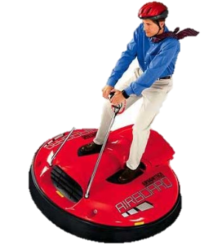
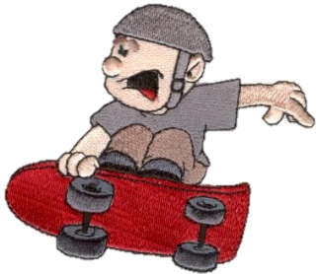
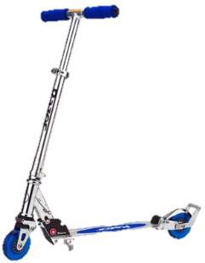
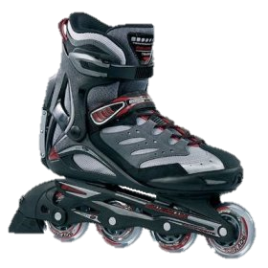
Balanced Discussion
or
Should be able to
Should NOT be able to
Should children be allowed to ride skateboards, roller blades, scooters or hover boards in the playground at break times?

Slide 8
Should children be allowed to ride skateboards, roller blades, scooters or hover boards in the playground at break times?
Against
* children would get seriously hurt * cost of them * arguments over who has best one * too crowded on the playground * children too excitable * storage problems * responsibility for breaking them * electrical charging hover board * IT room not used anymore
For
* unfair for KS1 * make new friends through playing together * playgrounds less boring * good exercise (obesity) * less truancy * waste less time - grab 'n' go * plenty of room (big field for hover boards) * develop creative skills

Slide 9
Discussion Text Success
Remember to:
* Write a title that says what you are discussing.
* Write an introduction that tells the reader what the discussion Is about.
* Write in a logical order. Start each new section with a topic sentence.
* Write one paragraph for each point then do the same thing for the point against.
* Write a conclusion
It is important to...
* Write In the present tense and the third person (he, she...).
* Use technical vocabulary.
* Include words to show reasons (because, so...).
* Use connecting phrases to signal points (e.g. first of all...).
* Use 'weasel words' to back up points (probably...).
* Use phrases that signal both sides of an argument (e.g. some people believe...)
* Give facts to back up points.

Slide 10
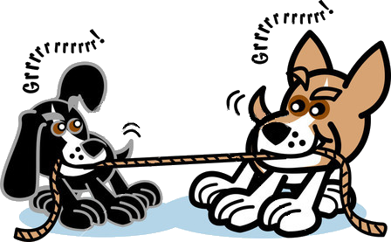
Argument and Discussion Connectives
Causal Connectives
Whenever
Therefore
Consequently
Because
Since
If
So
Agreement Connectives
As well as
Similarly
In addition
Additionally
Furthermore
Moreover
Also
Besides
Contradicting Connectives
Nevertheless
Critics argue
Although
But
However
On the contrary
Contrary to
On the other hand
Whereas

Slide 11
Other Ideas for Persuasive Arguments and Discussions
Should children have to complete homework? Should children be made to wear school uniform? Should children come to school at the weekend? Which make the best pets? Dogs or cats? Should animals be kept in zoos? Should animals be used for medical testing? Should ball games be stopped in the playground? Should children be allowed to have a 'class pet'? Should boys and girls have separate classes? Should children have to complete household chores?
Should animals perform in circuses?
Should Goldilocks have gone into forest to see grandma?
Are team games more fun?
Is Spring a better season than Autumn?

